Slide 1
Pattern Analysis
Neural Networks
“The methods of theoretical physics should be applicable to all those branches of thought in which the essential features are expressible with numbers.”
Paul M. Dirac (link)
(1902-1984)
Dr Shekhar “Shakes” Chandra shekhar.chandra@uq.edu.au
V1.0

Slide 2
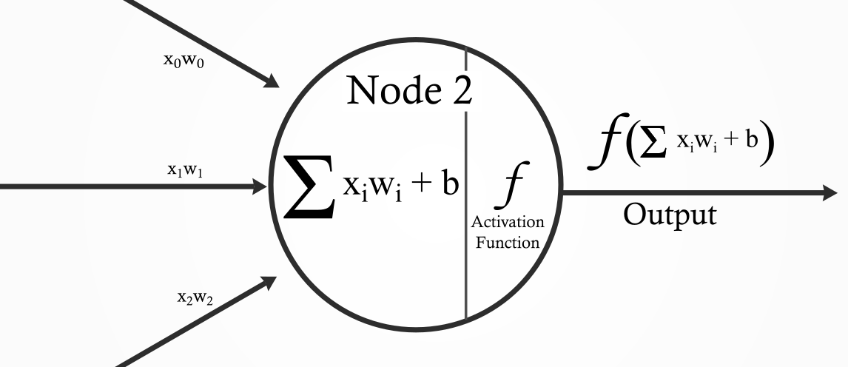
Neuron
Given an arbitrary number of input connections, each weighted by corresponding set of weights, activate only according to an activation function if weighted summation > threshold.
Bias
Weights
Linear Algebra
https://theffork.com/activation-functions-in-neural-networks/
#deep-learning-uq

Slide 3
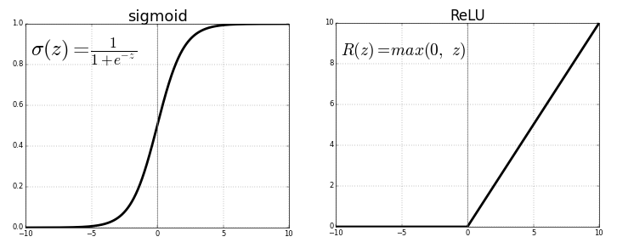
Activation Functions
https://theffork.com/activation-functions-in-neural-networks/
An activation function help the neuron “decide” whether to fire or not
Different sets of firing neurons will group together to complete sub-tasks of a given problem
The Sigmoid function is the most common theoretical activation function, while the ReLU is the most common practical theoretical activation function
The Sigmoid is too computational complex to use practically but shows the main purpose of the activation function
#deep-learning-uq

Slide 4
Activation Functions
https://theffork.com/activation-functions-in-neural-networks/
#deep-learning-uq

Slide 5
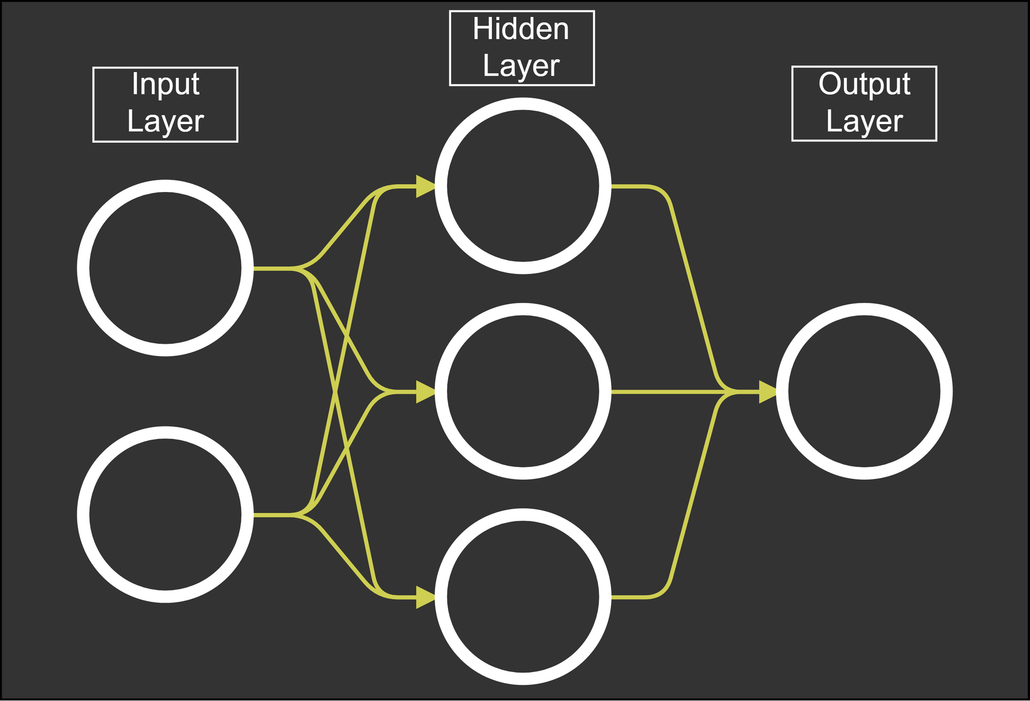
Neural Network
https://mlfromscratch.com/neural-networks-explained/#/
#deep-learning-uq

Slide 6
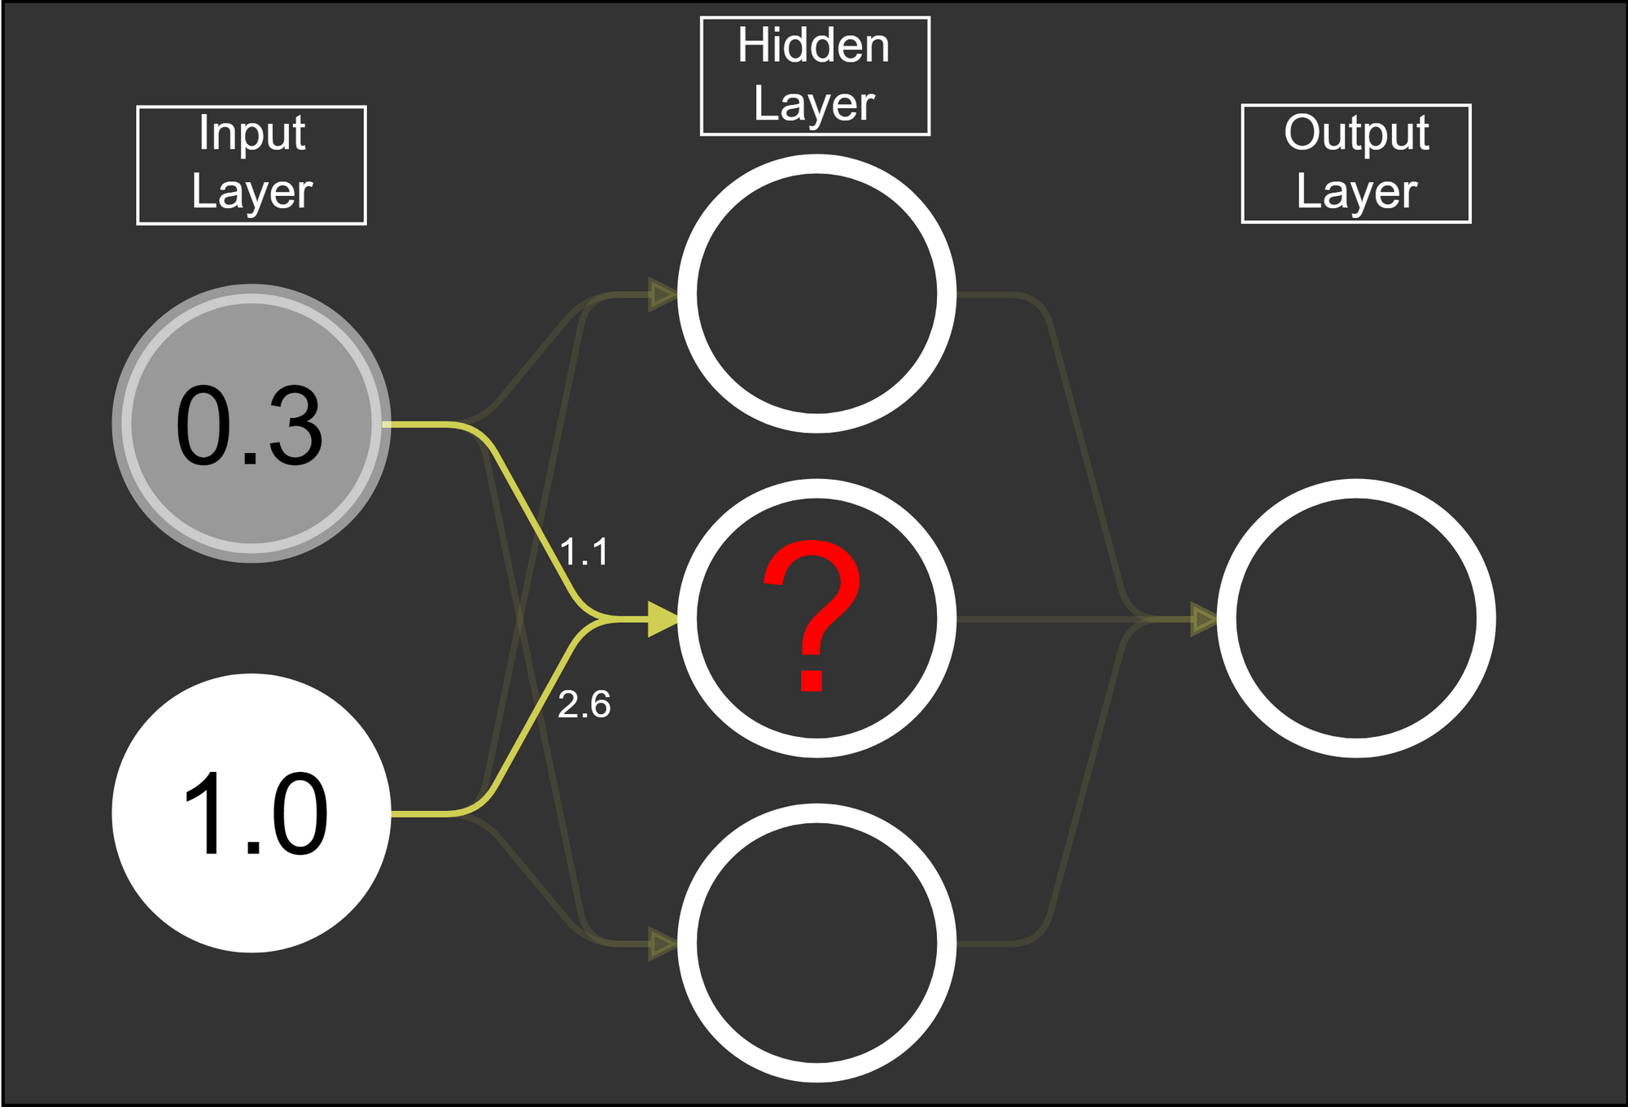
Neural Network
https://mlfromscratch.com/neural-networks-explained/#/
#deep-learning-uq

Slide 7
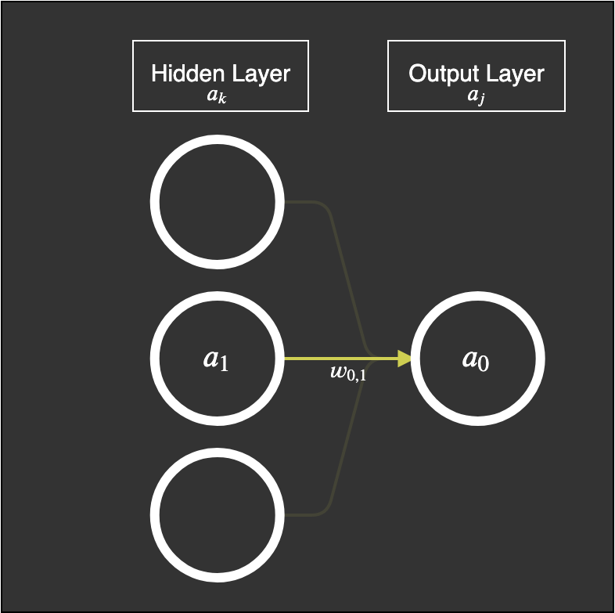
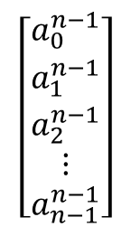
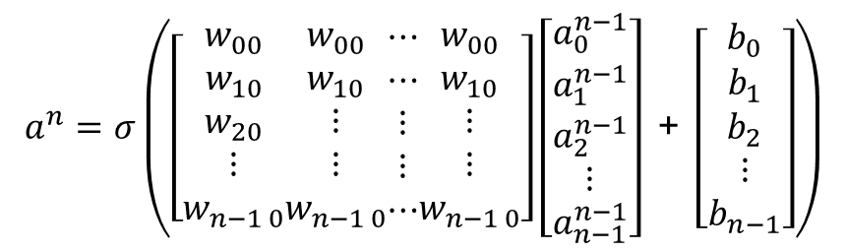
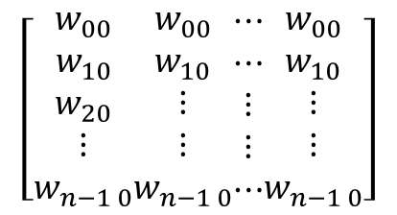

Neural Network
https://mlfromscratch.com/neural-networks-explained/#/
$$\left[\begin{aligned}a_{0}^{n−1} \\ a_{1}^{n−1} \\ a_{2}^{n−1} \\ ⋮ \\ a_{n−1}^{n−1}\end{aligned}\right]$$
All activations from previous layer $a^{n−1}$
All weights connected to each neuron in the next layer
$$\left[\begin{aligned}w_{00} \\ w_{10} \\ w_{20} \\ ⋮ \\ w_{n−1 0}\end{aligned}\begin{aligned}w_{00} \\ w_{10} \\ ⋮ \\ ⋮ \\ w_{n−1 0}\end{aligned}\begin{aligned}⋯ \\ ⋯ \\ ⋮ \\ ⋮ \\ ⋯\end{aligned}\begin{aligned}w_{00} \\ w_{10} \\ ⋮ \\ ⋮ \\ w_{n−1 0}\end{aligned}\right]$$
Pass resulting matrix multiplication through the activation function $σ$
$$a^{n}=σ\left(\left[\begin{aligned}w_{00} \\ w_{10} \\ w_{20} \\ ⋮ \\ w_{n−1 0}\end{aligned}\begin{aligned}w_{00} \\ w_{10} \\ ⋮ \\ ⋮ \\ w_{n−1 0}\end{aligned}\begin{aligned}⋯ \\ ⋯ \\ ⋮ \\ ⋮ \\ ⋯\end{aligned}\begin{aligned}w_{00} \\ w_{10} \\ ⋮ \\ ⋮ \\ w_{n−1 0}\end{aligned}\right]\left[\begin{aligned}a_{0}^{n−1} \\ a_{1}^{n−1} \\ a_{2}^{n−1} \\ ⋮ \\ a_{n−1}^{n−1}\end{aligned}\right]\text{ + }\left[\begin{aligned}b_{0} \\ b_{1} \\ b_{2} \\ ⋮ \\ b_{n−1}\end{aligned}\right]\right)$$
#deep-learning-uq

Slide 8
Backpropagation
We determine the change required to weights and biases in order to get the desired output.
We are able to adjust all weights biases of all layers except the input layer, where the data is input to the network.
We learn all the weights within the neural network we have designed to give us the suitable results from our network in the output layer.
Therefore, we compute the network “backwards” one step as a time to get the weights required.
This is called back propagation and further details are outside the scope of this course.
How? Through optimization …
#deep-learning-uq

Slide 9
Gradient Descent
We evaluate how close we are to the desired output using a metric (such as mean squared error and use it as a cost function. Then the task is reduced to find the global minima of this function.
GIF of a 3blue1brown video
#deep-learning-uq

Slide 10
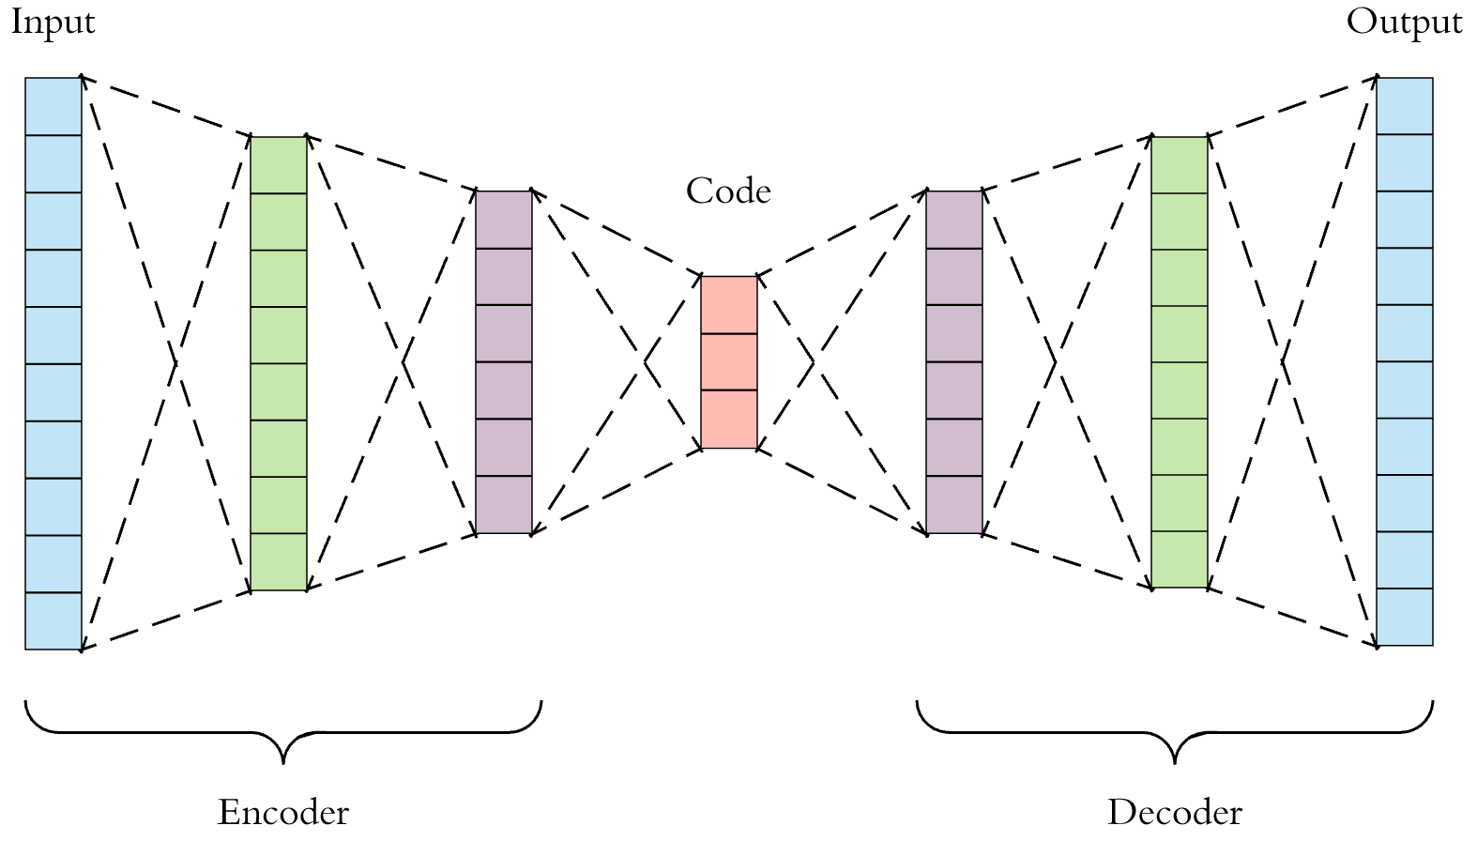
Autoencoder
https://towardsdatascience.com/applied-deep-learning-part-3-autoencoders-1c083af4d798
See also https://blog.keras.io/building-autoencoders-in-keras.html
#deep-learning-uq

Slide 11
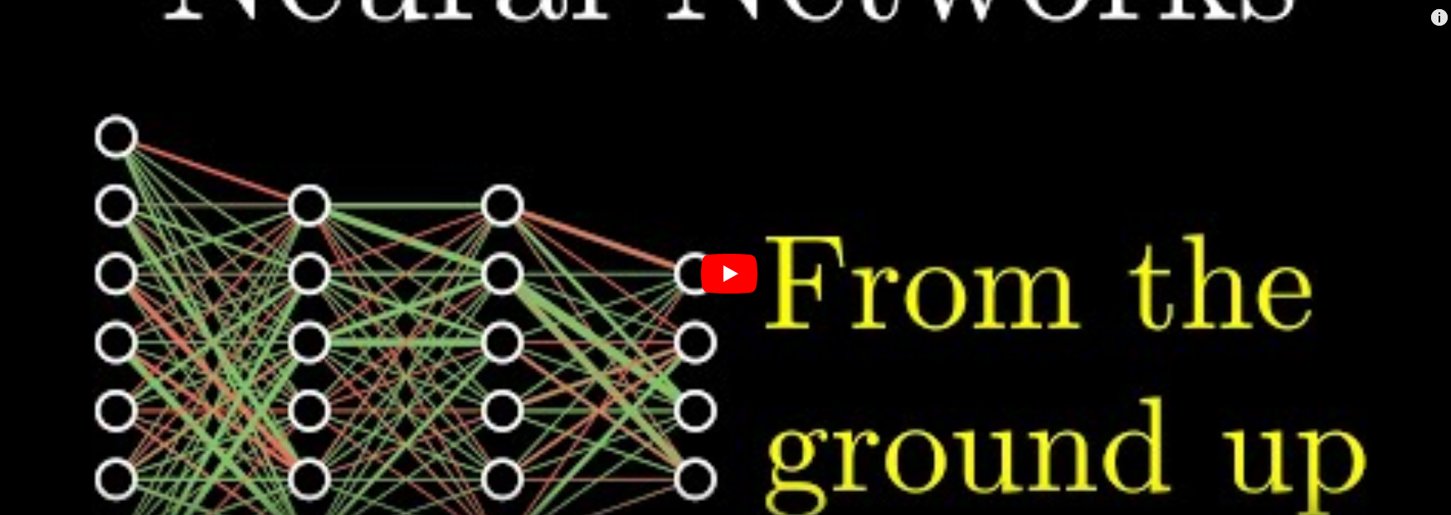
#deep-learning-uq

Slide 12
Conclusion
Neurons are individual nodes that can make a “decision” based on its inputs via an activation
Groups of neurons can work together to complete sub-tasks by linking together into a network connected by weights and these activations
We can teach the network to learn how to get from required inputs to desired outputs by creating different network structures
The learning process is facilitated by finding the local/global minima of a cost function defining the learned output result and desired results
Autoencoders can learn latent spaces that represent data just like the PCA
#deep-learning-uq

Slide 13
What’s Next?
How can we process spatial relationships using convolutional neural networks …
#deep-learning-uq

Slide 14


Thank you
Dr Shekhar “Shakes” Chandra | Lecturer
School of Information Technology and Electrical Engineering
shekhar.chandra@uq.edu.au
+61 7 3365 8359
@shakes76
shekhar-s-chandra

